Slide 1
Module II - INHERITANCE
Vaishali R. Kandekar

Slide 2
Contents
Introduction to inheritance
Relation between access modifiers and visibility modes
Defining derived classes
Types of inheritance: single, multi-level, multiple, Hierarchical and hybrid.
Passing parameters to base class constructors
Function overriding
Friend class
Nested class
Virtual base classes
Abstract classes

Slide 3
Outcomes
Understand the concept of inheritance in C++
Explore access modifiers and their role in inheritance
Learn about visibility modes and how they impact data access
Define and implement derived classes with examples

Slide 4
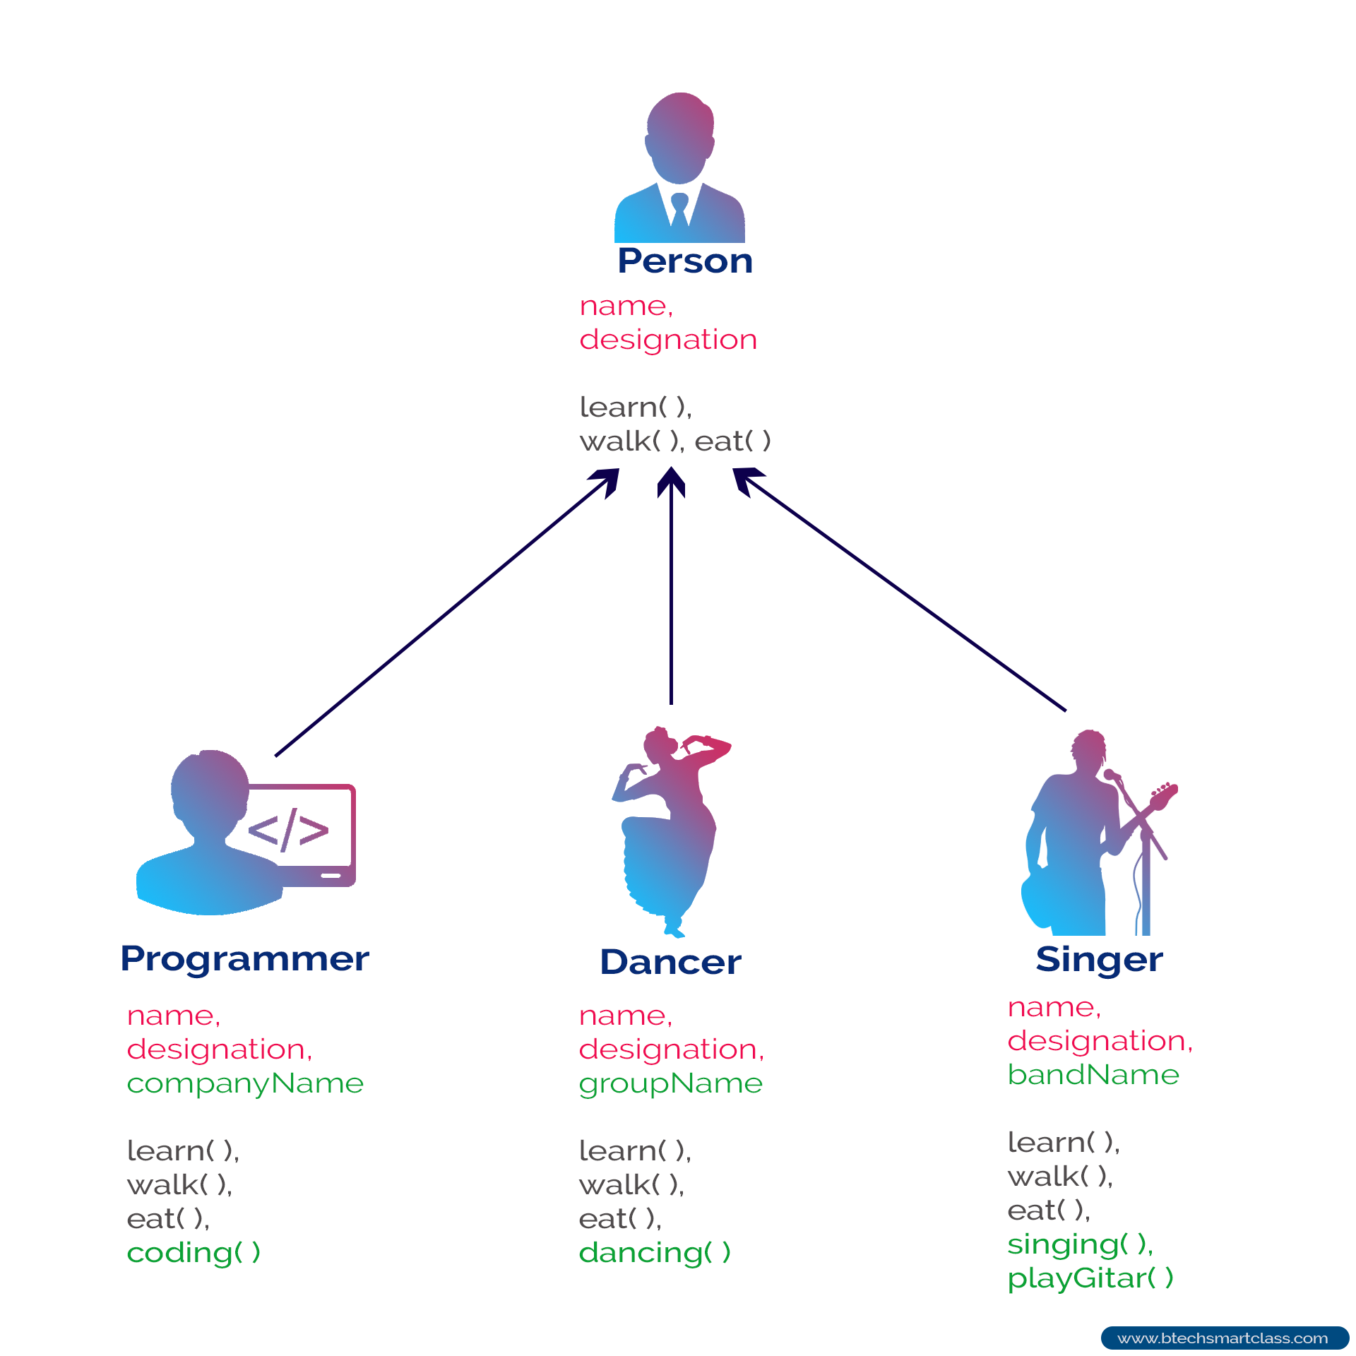
Introduction to inheritance

Slide 5
Introduction to inheritance
Inheritance is a mechanism where one class (child) acquires properties and behavior from another class (parent).
The class which provides properties is called as parent class and the class which receives the properties is called as child class.
The parent class is also known as base class or supre class.
The child class is also known as derived class or sub class.
Eg: inheritance as a family trait: A child inherits characteristics (eye color, height) from their parents, just like a child class inherits attributes (variables) and behaviors (functions) from a parent class.

Slide 6
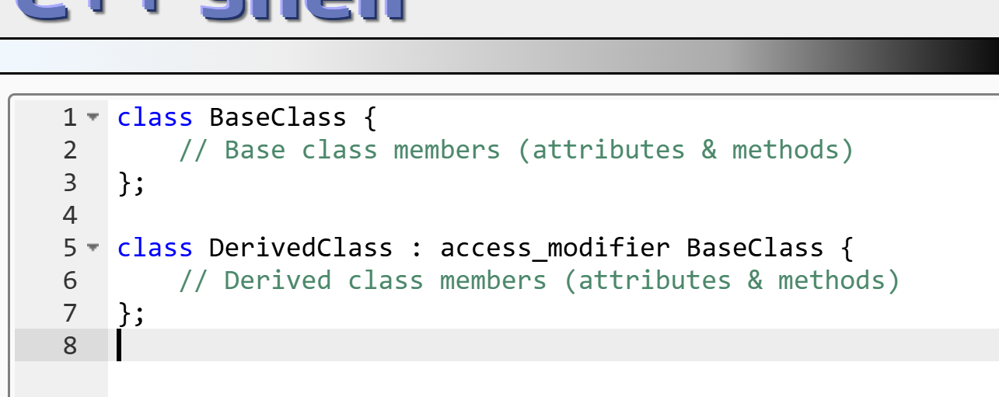
FEATURES of inheritance
Code Reusability: Reduces duplicate code by reusing parent class features.
Hierarchical Structure: Establishes relationships between classes (e.g., Animal → Dog).
Extensibility: Allows adding new features to an existing system.
Overriding: The child class can modify the inherited behavior.

Slide 7
Access Specifiers & Visibility Mode in Inheritance
public: Members remain public in the derived class
protected: Members become protected in the derived class
private: Members become private in the derived class (not inherited by child classes)

Slide 8
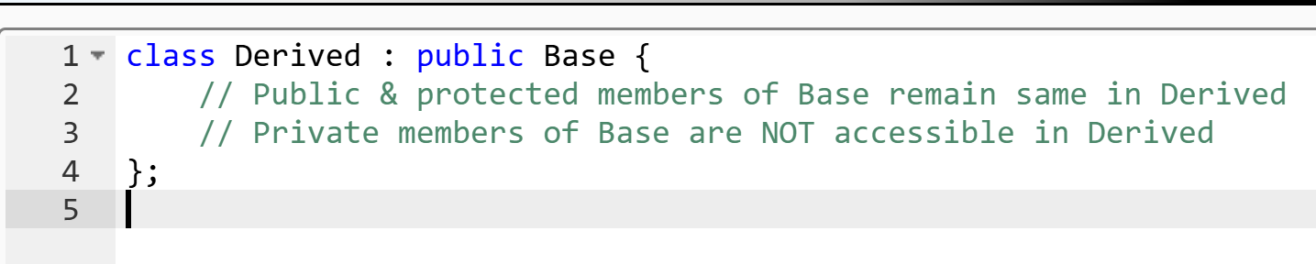
Public Inheritance
✔ Public & protected members of Base remain same in Derived.
❌ Private members of Base are not accessible in Derived.

Slide 9
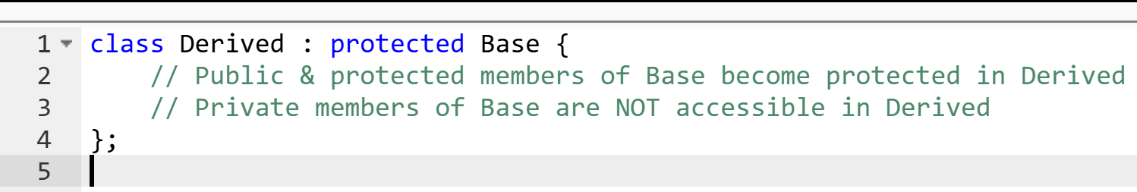
Protected Inheritance
✔ Public & protected members of Base become protected in Derived.
❌ Private members of Base are still inaccessible.

Slide 10
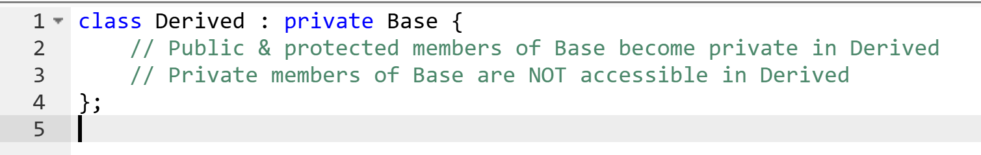
Private Inheritance
✔ All members of Base (except private) become private in Derived.
❌ Private members of Base remain inaccessible.

Slide 11
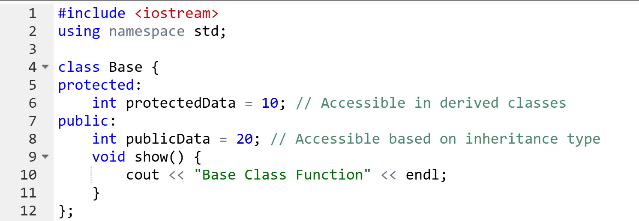
Example Program Using All Three Types

Slide 12
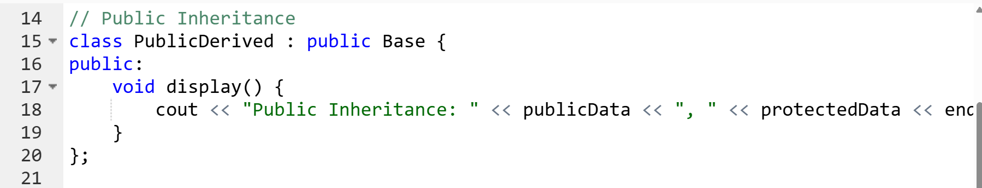
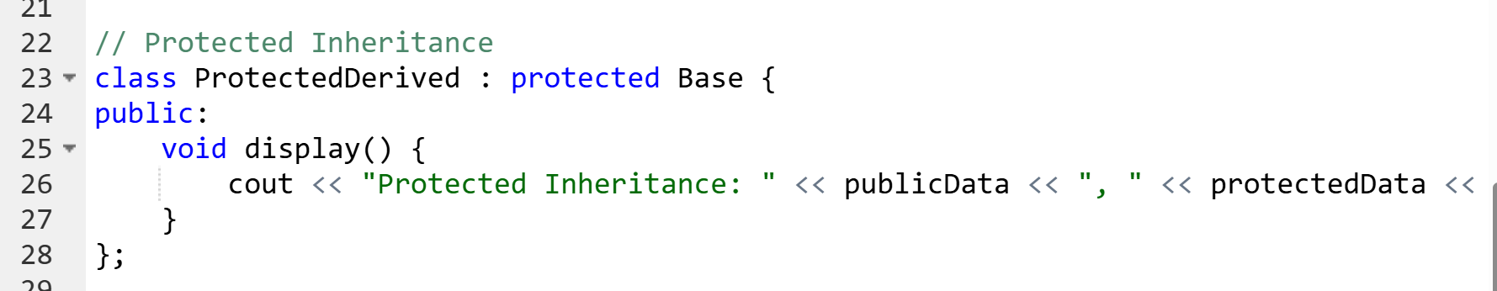
Example

Slide 13
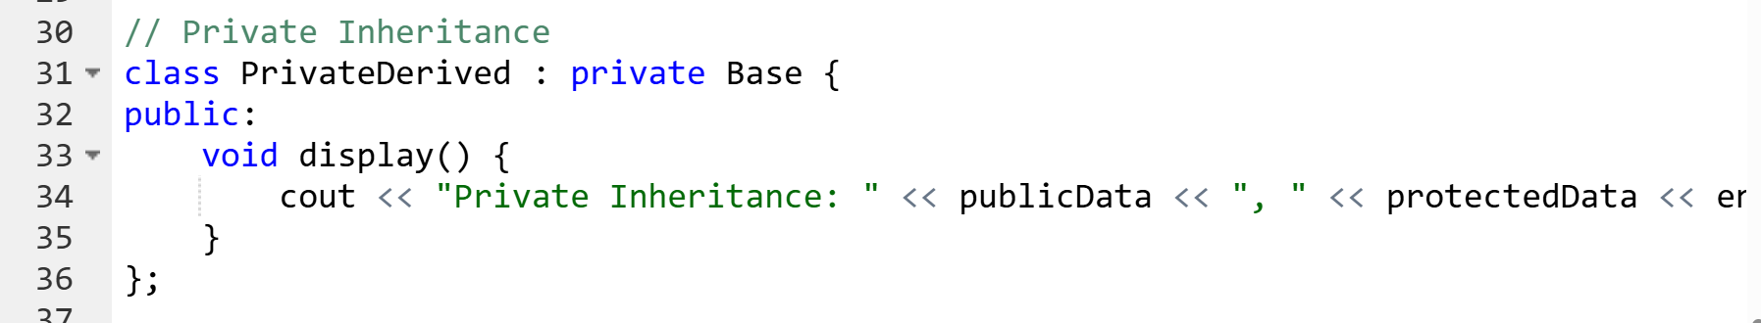
Example

Slide 14
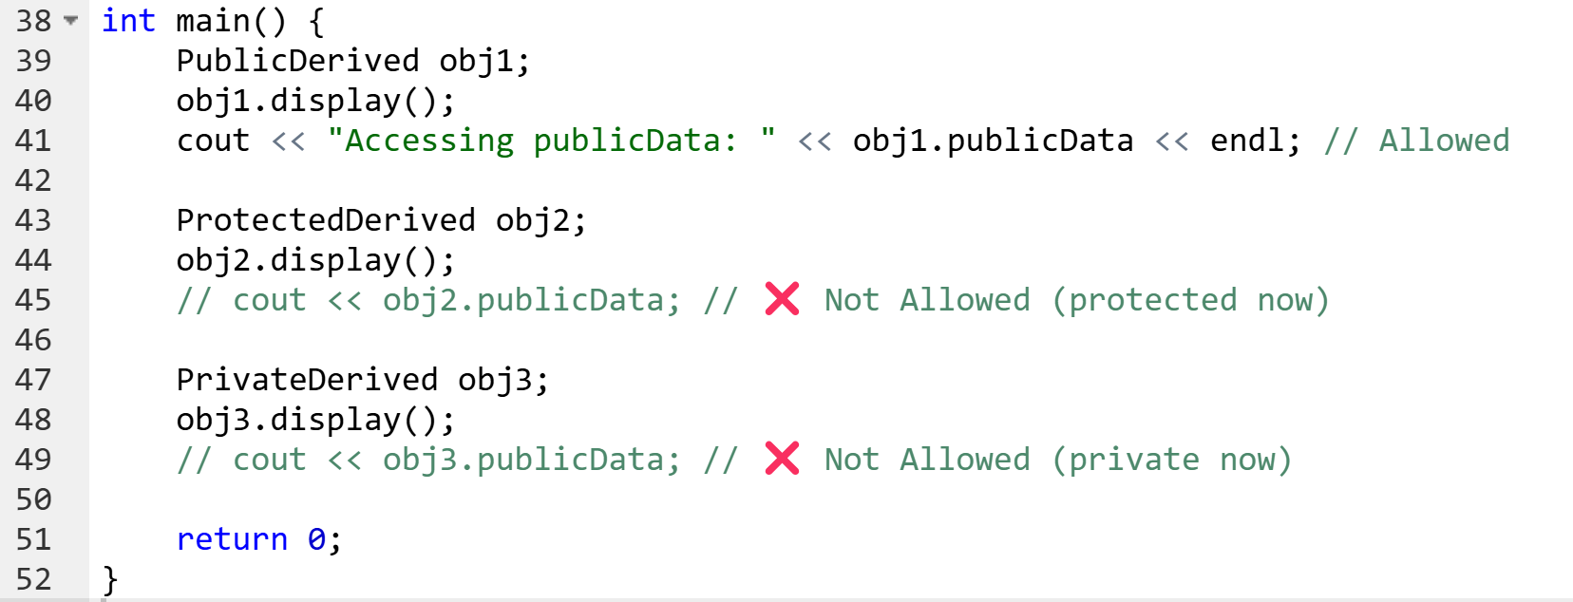

Example

Slide 15
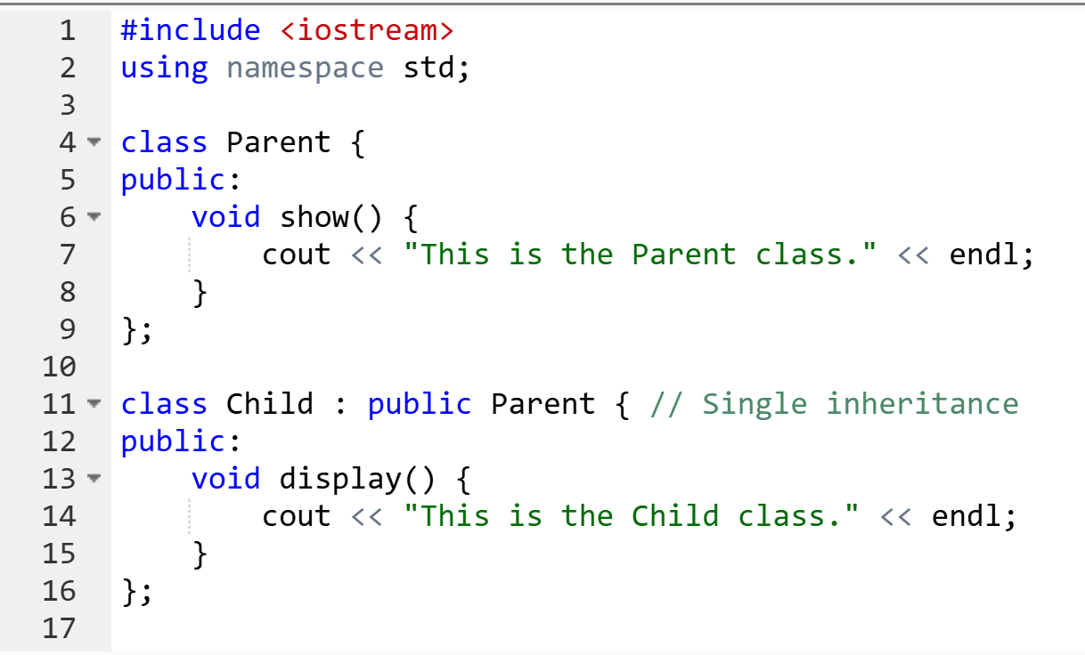
Single Inheritance
A single derived class inherits from a single base class.

Slide 16
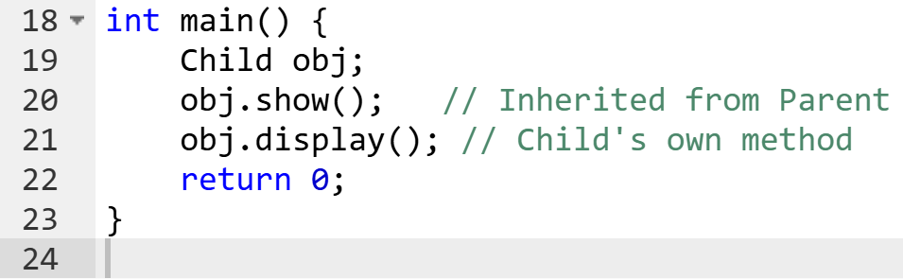

Single Inheritance

Slide 17
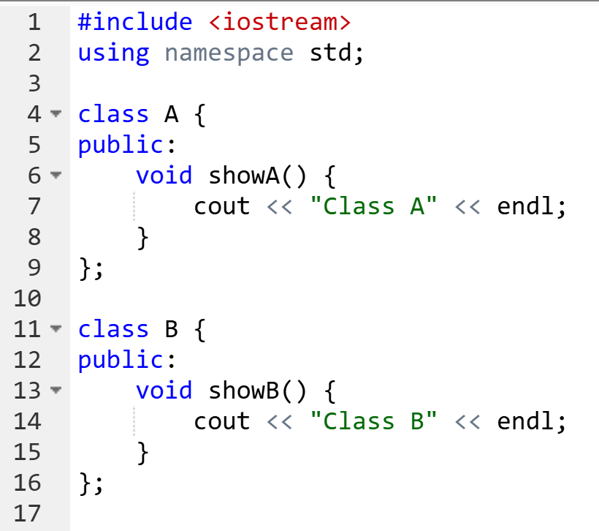
Multiple Inheritance
A single derived class inherits from two or more base classes.

Slide 18
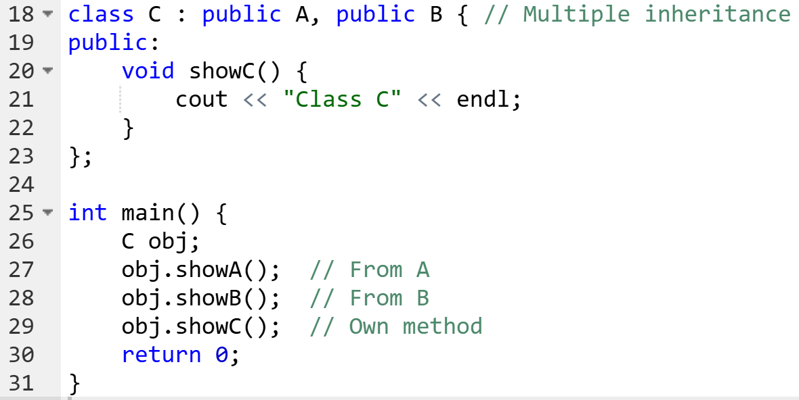

Multiple Inheritance

Slide 19
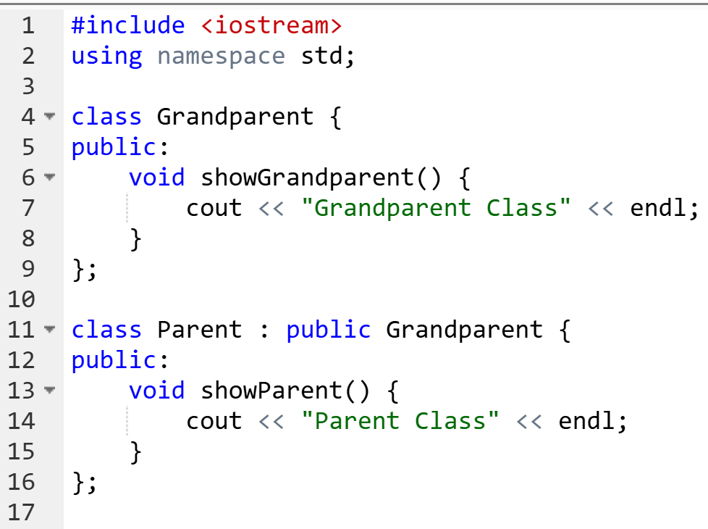
Multilevel Inheritance
A class is derived from another derived class (i.e., inheritance occurs in multiple levels).

Slide 20
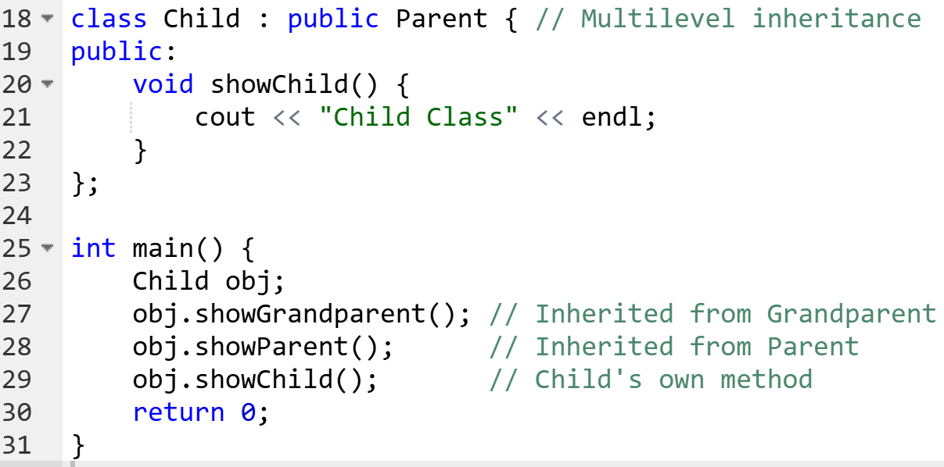
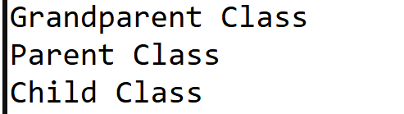
Multilevel Inheritance

Slide 21
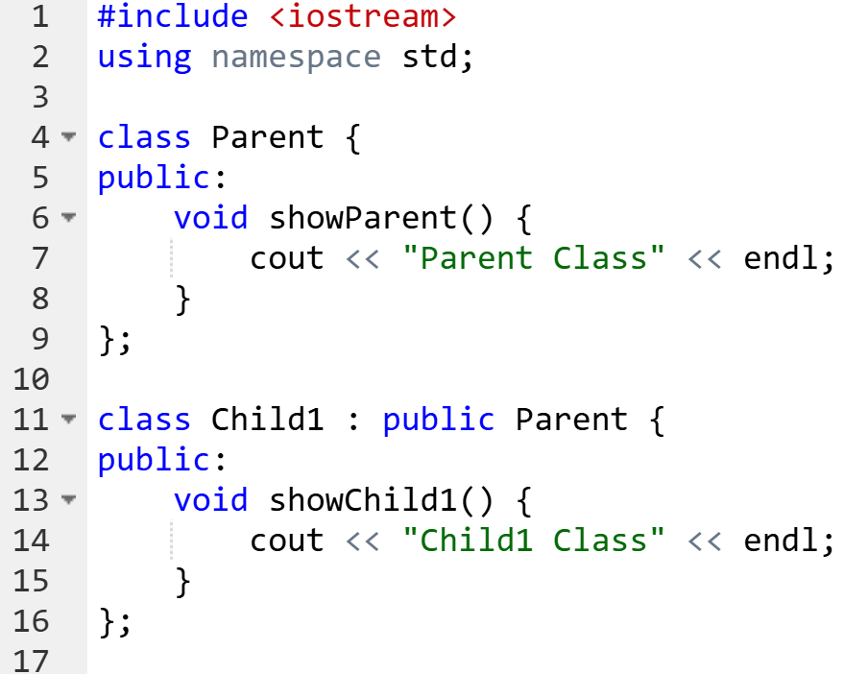
Hierarchical Inheritance
A single base class has multiple derived classes.

Slide 22
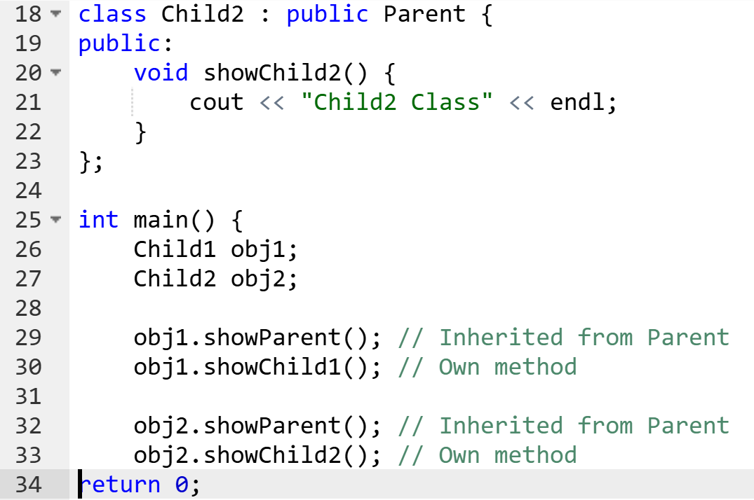
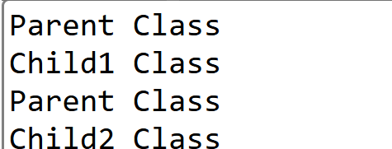
Hierarchical Inheritance

Slide 23
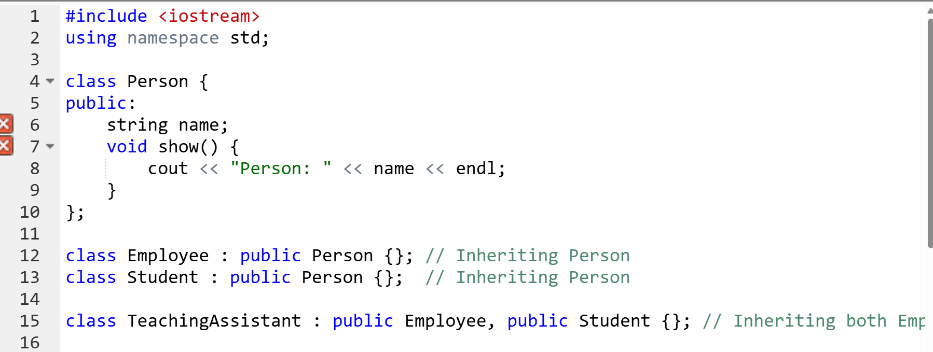
Hybrid (Virtual) Inheritance
It is a combination of multiple and hierarchical inheritance, often using the virtual base class to avoid ambiguity.
If a class inherits from two classes that both inherit from a common base, duplicate copies of the base class appear.
virtual inheritance prevents this issue.

Slide 24
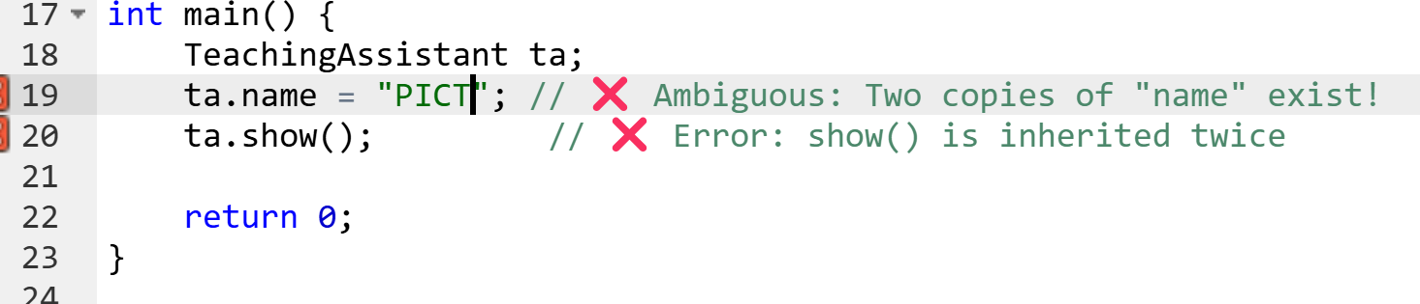
Error: ta.name is ambiguous because it exists twice (once from Employee, once from Student).

Slide 25
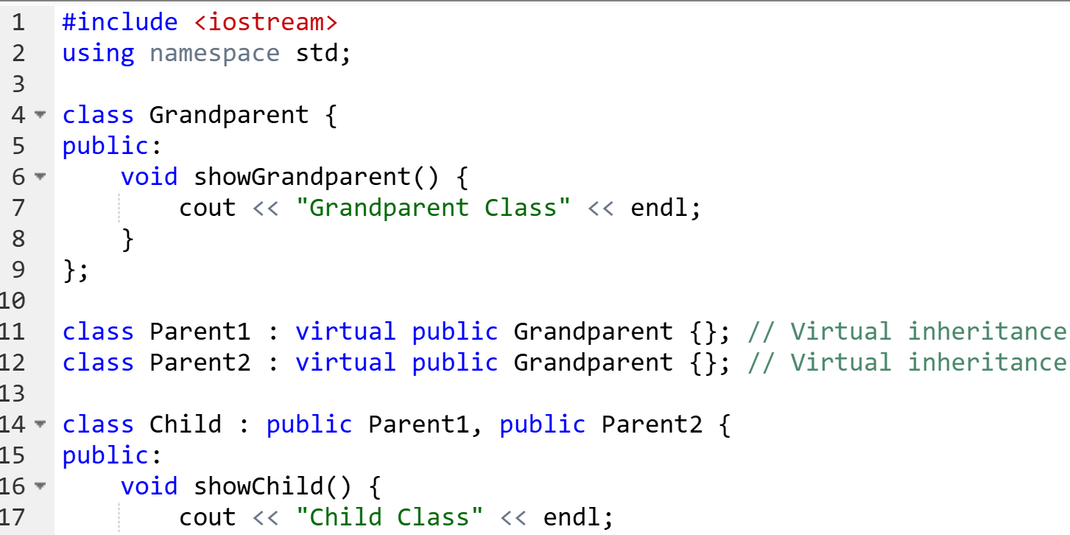
Hybrid (Virtual) Inheritance

Slide 26
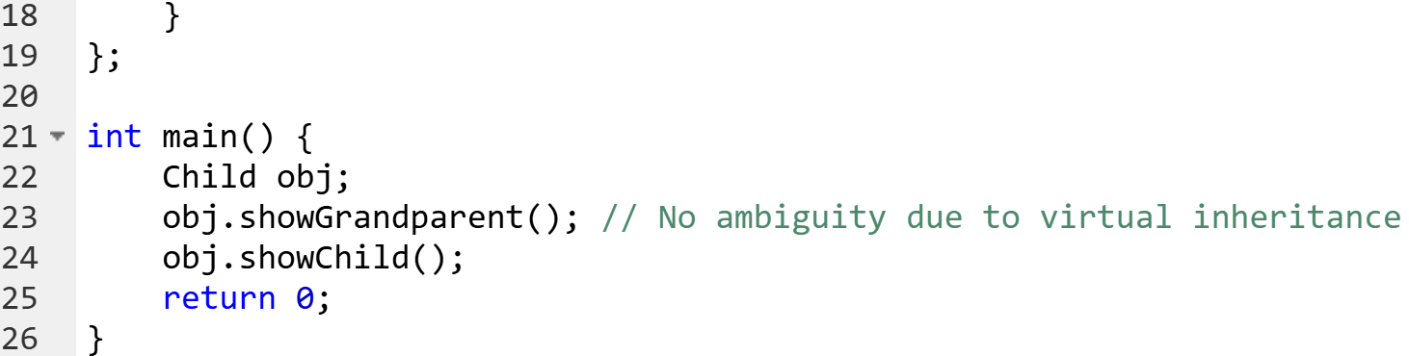

Hybrid (Virtual) Inheritance

Slide 27
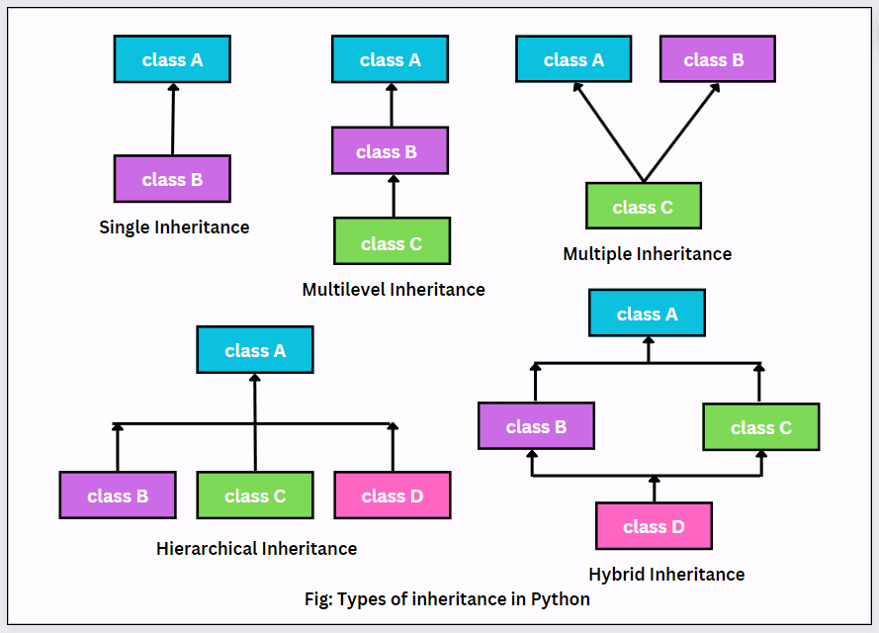
Types of Inheritance

Slide 28
Types of Inheritance
Type | Description | Example
Single | One derived class inherits from one base class | Parent → Child
Multiple | One derived class inherits from multiple base classes | A + B → C
Multilevel | A derived class is inherited by another derived class | Grandparent → Parent → Child
Hierarchical | One base class has multiple derived classes | Parent → (Child1, Child2)
Hybrid (Virtual) | Combination of multiple and hierarchical inheritance, avoiding ambiguity using virtual | Grandparent → (Parent1, Parent2) → Child

Slide 29
Which inheritance should be used?
Scenario 1: Employee Management System
A company has a general Employee class that stores basic details like name, ID, and salary. The company also has Permanent Employees, who receive additional benefits like health insurance.
💡 ?
Scenario 2: Smart Devices
You are designing software for smart home devices.
SmartDevice is the base class, containing common features like turning ON/OFF.
SmartBulb and SmartSpeaker inherit from SmartDevice.
A SmartHomeAssistant (like Alexa) inherits from both SmartSpeaker and SmartBulb to have both functionalities.
💡 ?

Slide 30
Which inheritance should be used?
Scenario 3: Vehicles : You are creating a vehicle management system.
The Vehicle class stores common properties like speed, fuel type, and model.
Car is a type of Vehicle.
ElectricCar is a type of Car that has additional attributes like battery percentage and charging time.
💡 ?
Scenario 4: University System : A university has:
TeachingStaff (Professors, Lecturers).
ResearchStaff (Ph.D. candidates, Project Assistants). A Professor can also be a ResearchStaff if they are leading a research project.
💡 ?

Slide 31
Which inheritance should be used?
Scenario 5: Automobile Components : A Vehicle class contains common attributes like speed, fuel type, and capacity.
A Car is a type of Vehicle.
A Truck is a type of Vehicle.
A Bike is also a type of Vehicle.
💡 ?

Slide 32
Passing parameters to base class constructors
When a derived class inherits from a base class, it may need to pass values to the base class constructor to properly initialize the base class members before executing the derived class constructor.
Since private members of the base class are not directly accessible in the derived class, the only way to initialize them is by passing parameters to the base class constructor from the derived class using an initialization list.
How Constructors Work in Inheritance
When an object of a derived class is created, the base class constructor executes first.
If the base class has a parameterized constructor, the derived class must pass arguments to it.
This is done using the constructor initialization list.

Slide 33
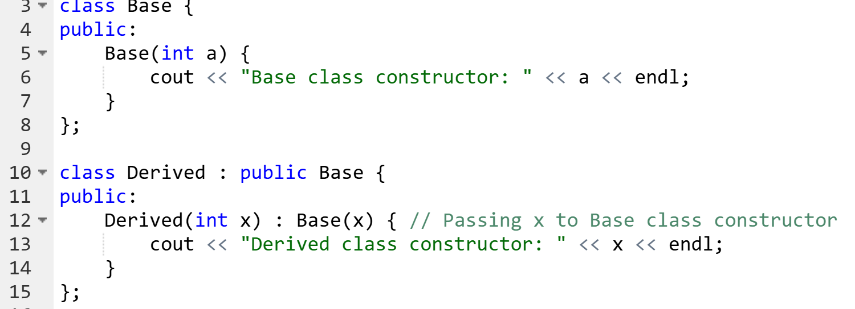
Passing parameters to base class constructors
Syntax
Base(x) inside the Derived constructor calls the base class constructor first, before executing any derived class code.

Slide 34
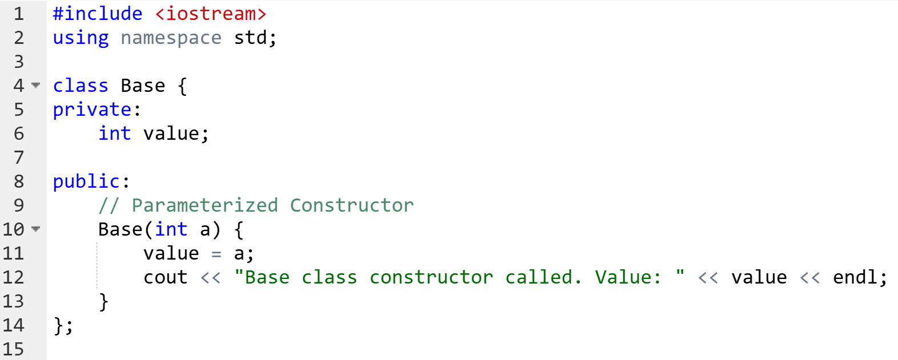
Example 1: Passing Parameters to Base Class
The Base constructor executes first
The Derived constructor executes next

Slide 35
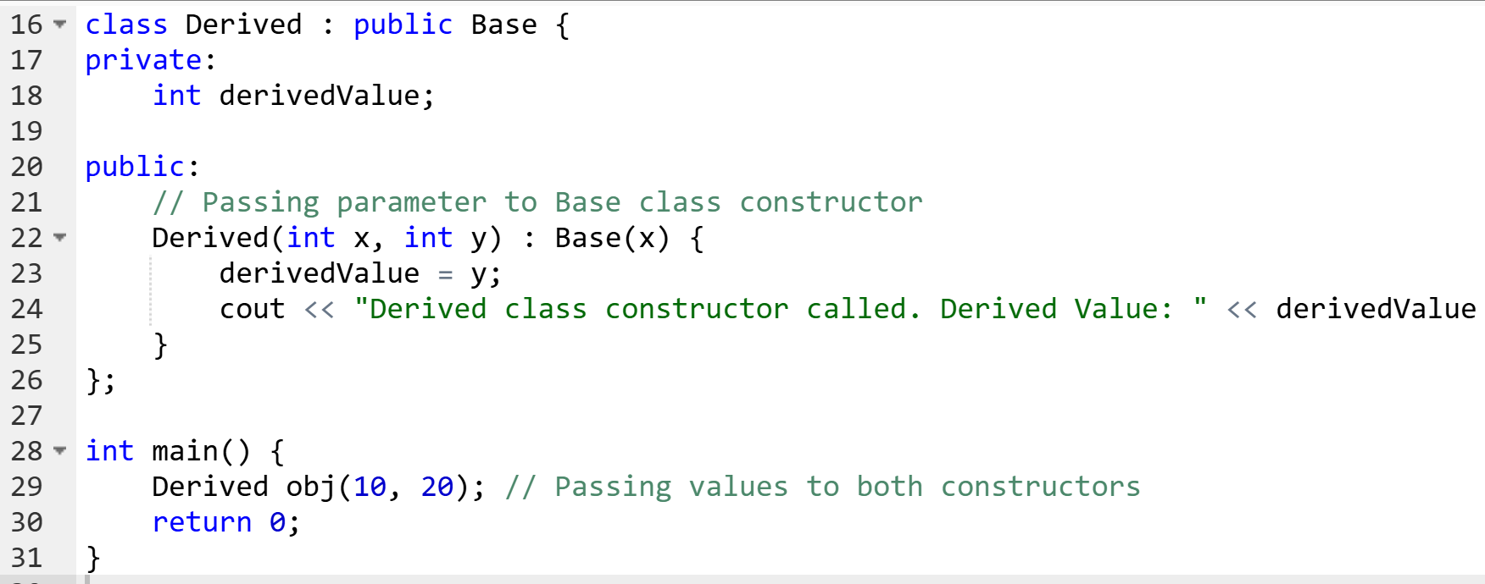
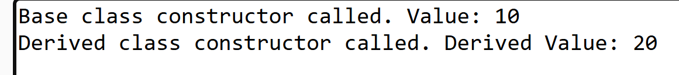
Example 1: Passing Parameters to Base Class

Slide 36
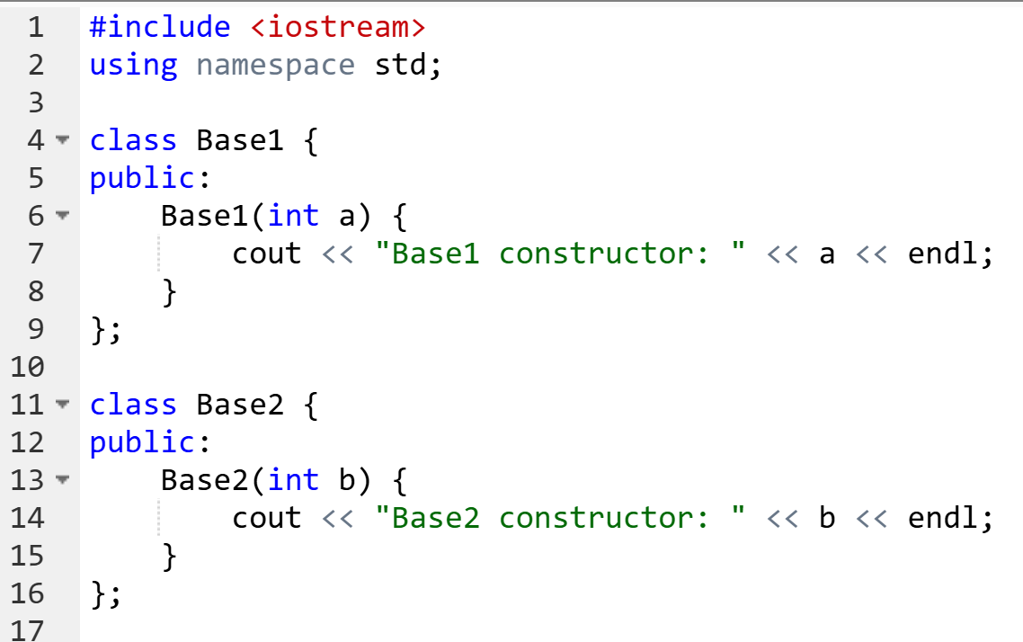
Example 2: Multiple Inheritance with Base Class Constructor Parameters
When a class inherits from multiple base classes, we must pass arguments to each base class separately. Base1 and Base2 constructors execute first Derived constructor executes last

Slide 37
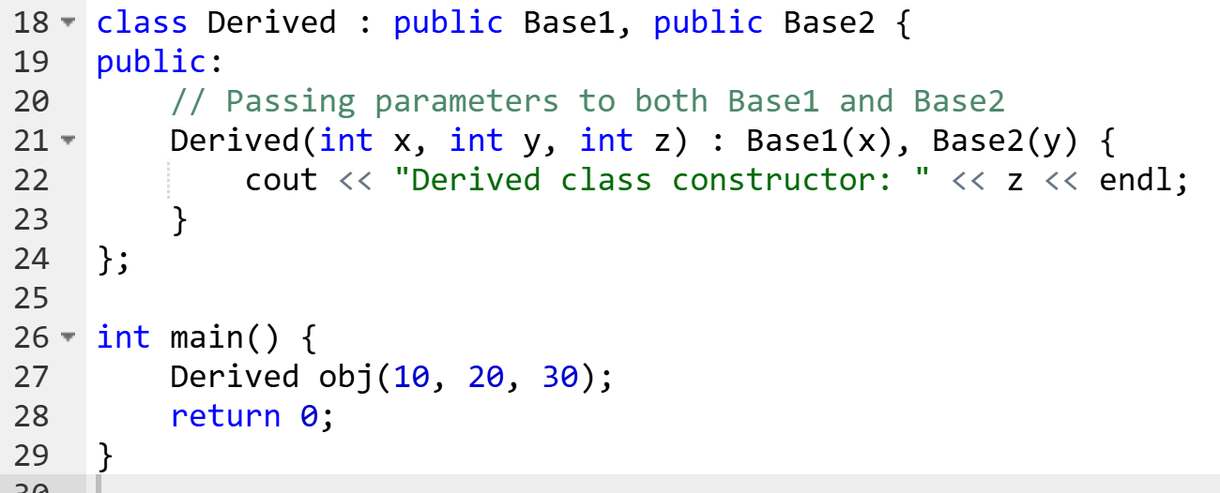
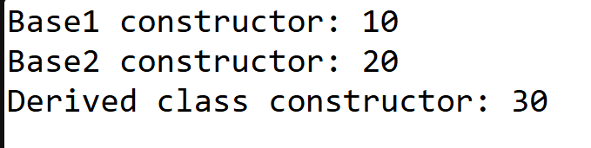
Example 2: Multiple Inheritance with Base Class Constructor Parameters

Slide 38
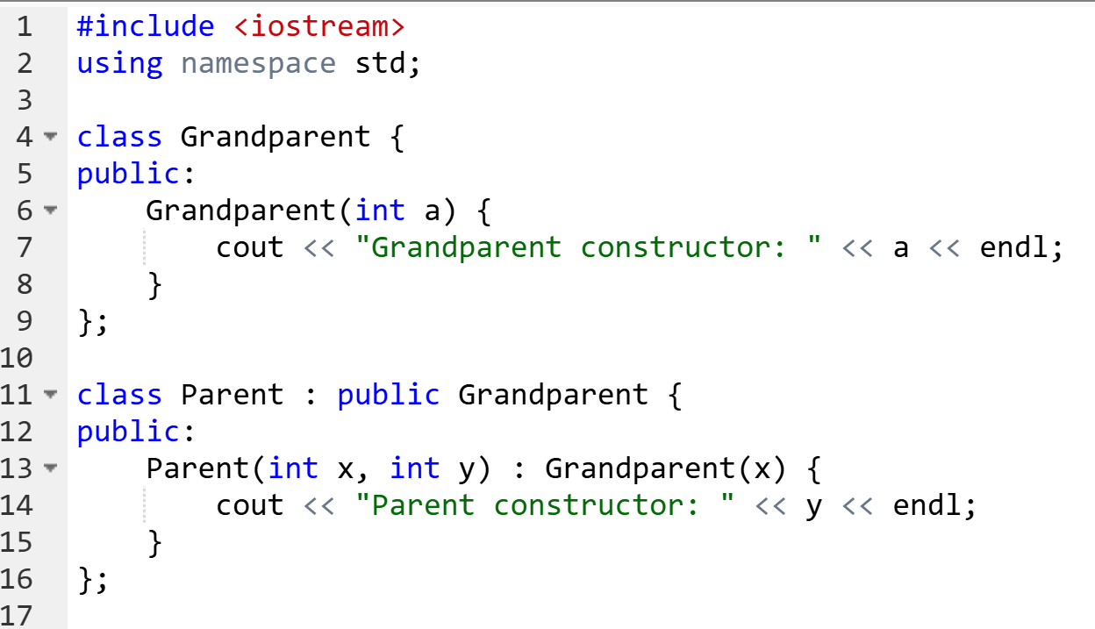
Example 3: Constructor Execution Order in Multilevel Inheritance
In multilevel inheritance, the base class constructor executes first, followed by the intermediate class constructor, and finally the derived class constructor.

Slide 39
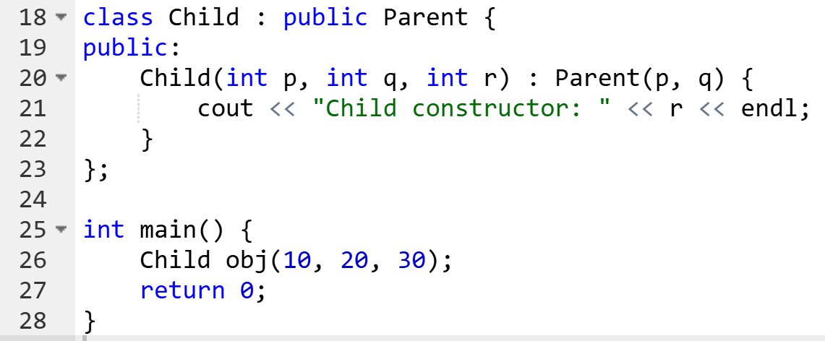
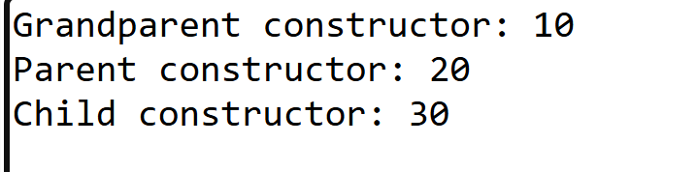
Example 3: Constructor Execution Order in Multilevel Inheritance

Slide 40
Example 3: Constructor Execution Order in Multilevel Inheritance
Grandparent constructor executes first
Parent constructor executes second
Child constructor executes last

Slide 41
Key Takeaways
Base class constructor executes first before derived class constructor.
Parameters can be passed using the constructor initialization list (: Base(x)).
In multiple inheritance, parameters must be passed to each base class individually.
In multilevel inheritance, constructors execute in order from base to derived.

Slide 42
Function Overriding
Function overriding happens when a child (derived) class redefines a function that is already present in the parent (base) class.
The function name and parameters must be the same in both classes.
A virtual keyword is used in the base class to allow dynamic function selection at runtime.

Slide 43
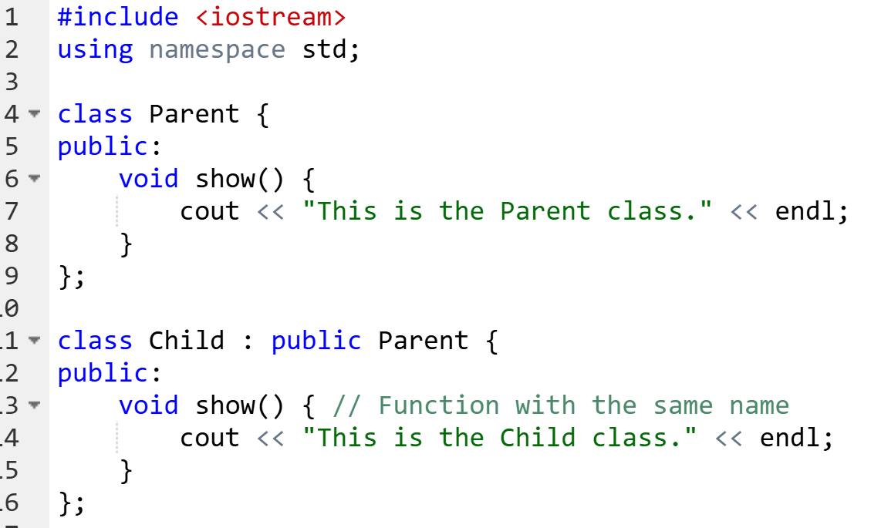
Example Without Overriding (Problem)
🔴 Problem: Even though p is pointing to a Child object, it still calls the Parent class function.

Slide 44
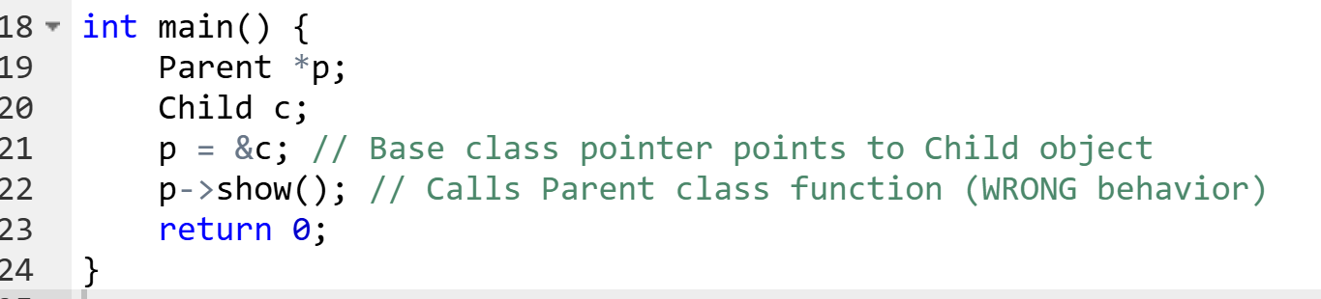

Example Without Overriding (Problem)
🔴 Problem: Even though p is pointing to a Child object, it still calls the Parent class function.

Slide 45
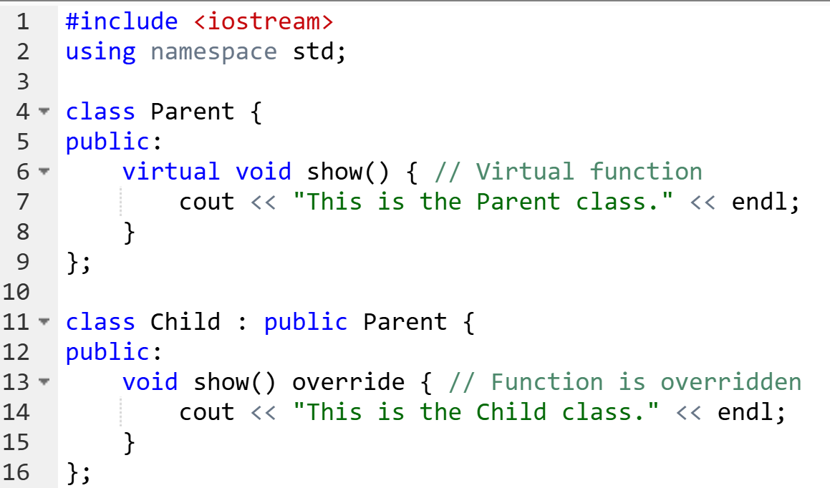
Solution: Use virtual for Function Overriding
Now, the correct function is called at runtime, thanks to virtual.

Slide 46
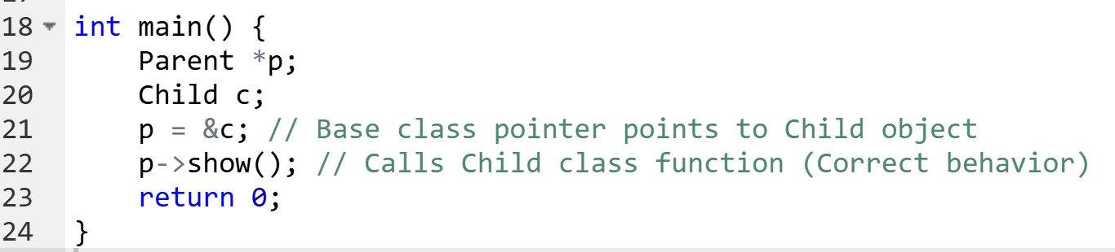

Solution: Use virtual for Function Overriding
Now, the correct function is called at runtime, thanks to virtual.

Slide 47
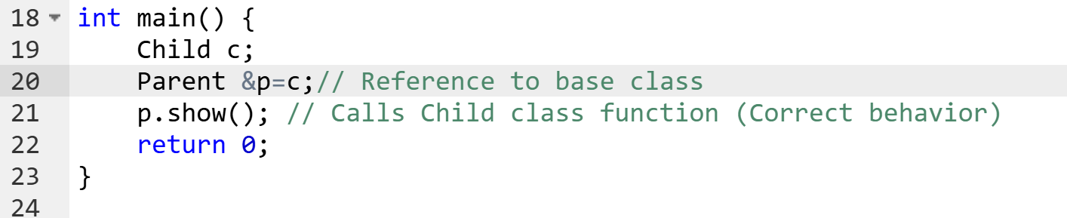
Overriding Using Reference

Slide 48
Difference Between Pointer vs. Reference in Overriding
Feature | Using Reference (&) | Using Pointer (*)
Syntax | Base& ref = obj; | Base* ptr = &obj;
Dereferencing Needed? | No, accessed directly | Yes, needs -> operator (ptr->show();)
Reassigning to Another Object | ❌ Not possible | ✅ Possible (ptr = &anotherObj;)
Null Value Allowed? | ❌ No (Base& ref = NULL; is invalid) | ✅ Yes (Base* ptr = NULL; is valid)

Slide 49
Function Overloading vs. Overriding
Feature | Function Overloading | Function Overriding
Definition | Same function name but different parameters in the same class | Same function name and parameters in base & derived class
Purpose | Improves code readability | Supports runtime polymorphism
Virtual Keyword | Not required | Required for dynamic binding

Slide 50
Key Takeaways
Overriding allows the derived class to modify inherited behavior.
virtual keyword in the base class enables runtime polymorphism.
A base class pointer calling an overridden function executes the derived class function.
Overriding doesn't work if objects are used directly (object slicing happens).
Use pointers (*) or references (&) to enable dynamic polymorphism.
References are safer (can't be NULL, must be assigned at initialization).
Pointers offer flexibility (can be reassigned, can be NULL).

Slide 51
Friend Class
A friend class is a class that is allowed to access private and protected members of another class.
It is used when two classes need to share private data but are not in an inheritance relationship.
When two classes need close interaction but are not related by inheritance
Sometimes, two classes work together and need direct access to each other's private data.
Instead of making data public (which breaks encapsulation), we use a friend class.

Slide 52
Friend Class
When we want to allow access to private data for specific classes only
Instead of making all data public, we grant access only to specific classes.
This improves security and modularity.
Useful in operator overloading
Friend functions/classes are often used for operator overloading, where an external function needs access to private members.

Slide 53
Friend Class
Use inheritance when one class is a specialized version of another:
"Car IS-A Vehicle" → class Car : public Vehicle
"Dog IS-A Animal" → class Dog : public Animal
"Student IS-A Person" → class Student : public Person
Use friend class when one class needs access to private members of another without being its subtype:
"Doctor HAS-A Patient" → Friend Class
"Librarian HAS-A Book" → Friend Class
"Mechanic HAS-A Car" → Friend Class

Slide 54
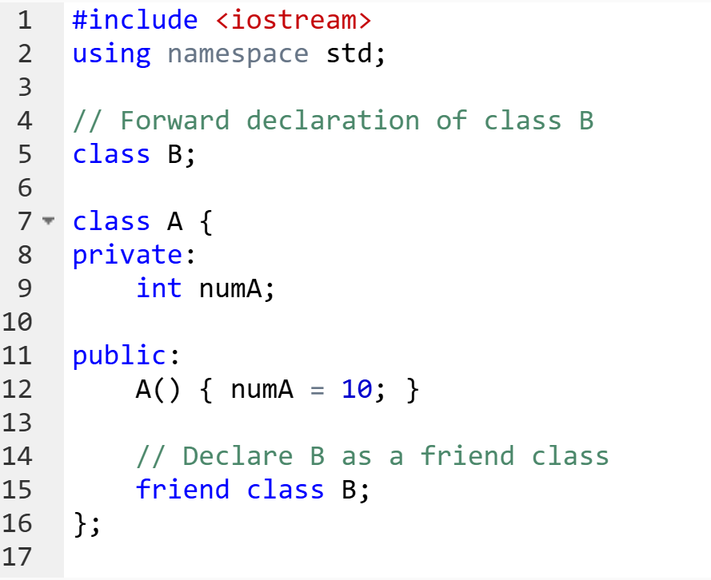
Friend Class

Slide 55
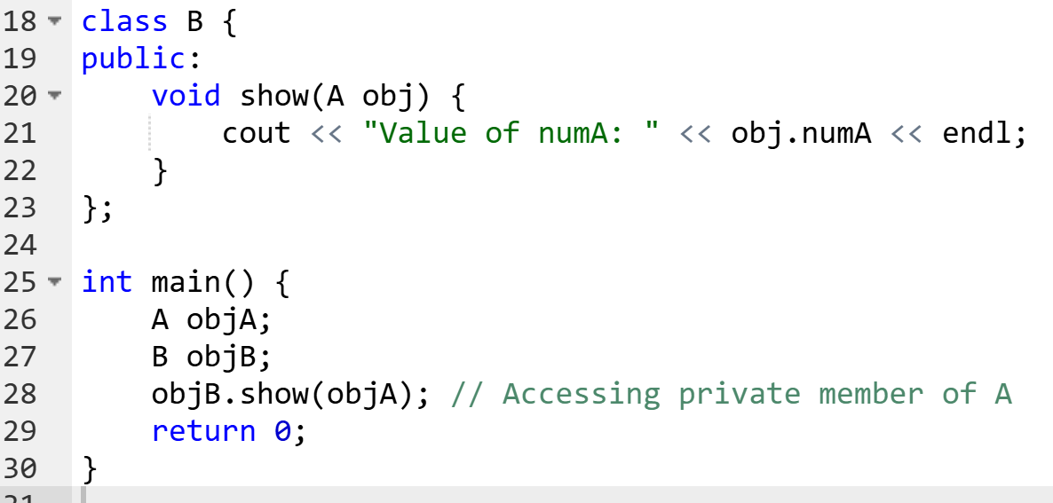

Friend Class

Slide 56
Nested Class
A nested class is a class defined inside another class
It helps in better data encapsulation when an inner class logically belongs to an outer class
It helps in logically grouping related functionality.
It can access private members of the outer class.
Why Use a Nested Class?
Encapsulation – Keeps related logic within the outer class. Better Organization – Helps in structuring complex programs. Access Control – Inner class can access private data of the outer class. Code Readability – Groups dependent functionality together.

Slide 57
Nested Class
Use a Nested Class when:
It is strongly dependent on the outer class.
It should not be used independently outside the outer class.
It logically belongs to the outer class.
Do NOT use a nested class when:
The inner class should be reusable elsewhere.
The inner class doesn’t require access to private data of the outer class.

Slide 58
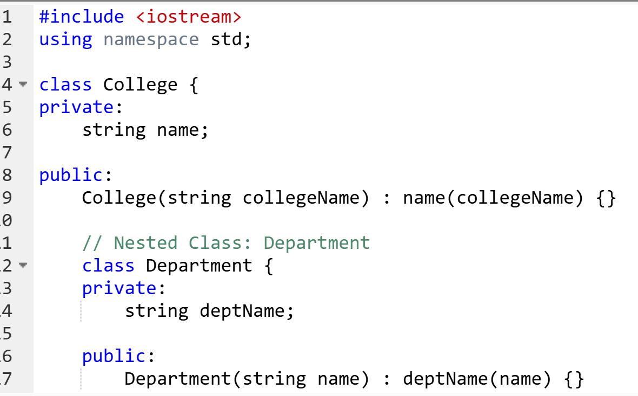
Nested Class
Example: A College has a Department : A Department class exists inside the College class because a department only makes sense inside a college.

Slide 59
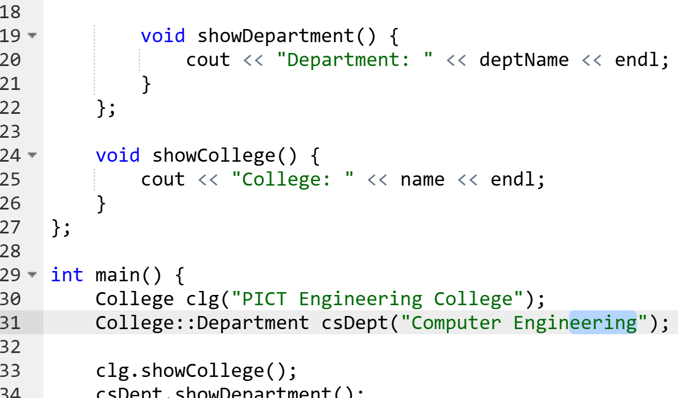

Nested Class

Slide 60
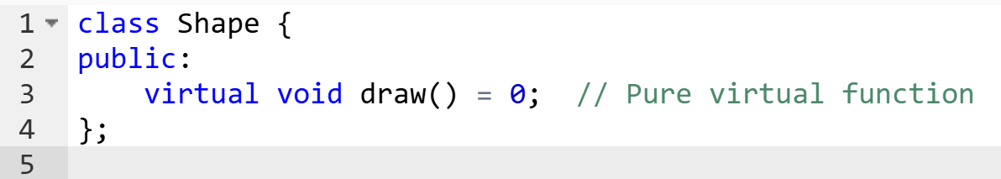
Abstract Classes
An abstract class in C++ is a class that has at least one pure virtual function.
A pure virtual function in C++ is declared by assigning it to zero (= 0) in the base class.
You cannot create an object of an abstract class.
It is used to define a common interface for all derived classes.

Slide 61
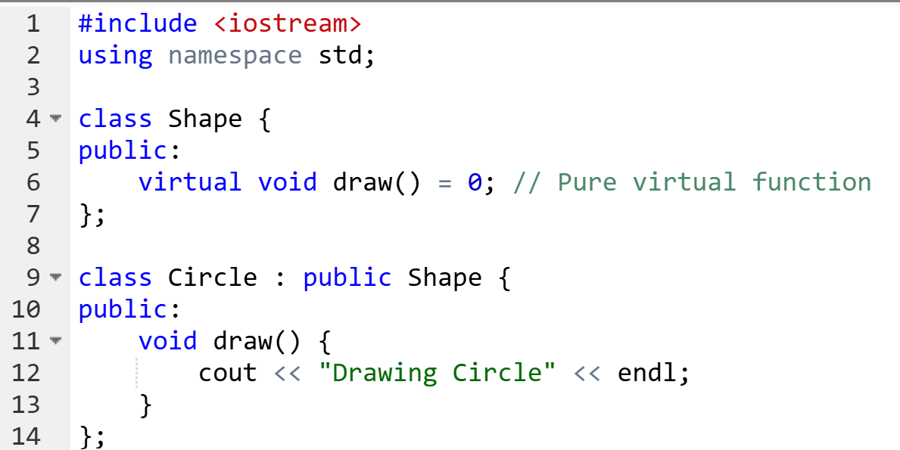
Abstract Classes
When you want to force derived classes to implement specific behavior.
To define interfaces or abstract base classes in frameworks or large systems.

Slide 62
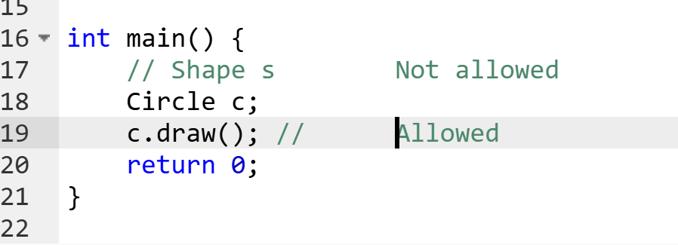
Abstract Classes
An abstract class must be inherited and all pure virtual functions must be implemented to create objects.

Slide 63
Abstract Classes
What does it mean?
You're telling the compiler: “This function has no body here, but must be implemented in the derived class.”
This makes the class abstract, meaning:
You cannot create an object of this class directly.
It acts as a blueprint for other classes.

Slide 64
Abstract Classes
Problem Title: Medical System Access Control
Design a simple system where a Doctor needs to access private Patient medical records, but only the doctor is allowed this access (no other class should be able to see it). Each patient has a name, age, and disease, all stored privately. The system should print the patient's record only when a Doctor checks it.
Write a system that enforces all the above behaviors using proper OOP features.

Slide 65
Abstract Classes
Problem Title: Multi-Tier Employee Hierarchy with Restricted Features Create a system for a company where:
There is a base Employee class that holds common attributes like name, ID, and a function display().
Several types of employees exist: Developer, Manager, and TeamLead.
Each derived class should override display() differently to show their role-specific information.
Additionally, the Manager can view some confidential information (e.g., bonus details) of the Developer, but this should not be accessible to others.
There’s a sub-component in the Developer class that internally manages tasks like CodeTracker, which should not be exposed outside. Write a system that enforces all the above behaviors using proper OOP features.

